Slide 1
GDPR Data Interoperability Model
Harshvardhan Pandit, Declan O’Sullivan,
Dave Lewis
ADAPT Centre, Trinity College Dublin
The ADAPT Centre is funded under the SFI Research Centres Programme (Grant 13/RC/2106) and is co-funded under the European Regional Development Fund.

Slide 2
Key GDPR Provisions
International reach: data about any EU citizen
Fines upto €20M or 4% of global turnover
Must Demonstrate compliance
Processing lawful only through Informed Consent

Slide 3
Data Subject Rights
Right to:
Information “concise, transparent, intelligible and easily accessible”
Make a subject access request
Rectification
Erasure
Data portability
Restrict access
Object to processing
Be inform who receives data

Slide 4
Approach
Role of entities
Information flows
Interoperability reference points
Major data categories
Map into Open Data models

Slide 5
GDPR Roles and Processes
Supervisory Authority
complaints
Data Controller
Data Subject
Compliance
Third Party Data Controller
Or
Data Processor
rights
rights
Monitor & Control
data
Processing
Sharing
data
workflow
dataset
workflow
workflow

Slide 6
GDPR Data Interoperability Reference Model
DS-SA
Supervisory Authority Function
SA-SA
SA-DC
DC-DC
Data Subject Function
DS-DC
Data Controller Function
DC-DP
DP-DP
DS-DP
Data Processor Function
DC-DM
DP-DM
DS-DM
Data Management Function

Slide 7
Interoperability between Entitites
Interaction Type
REQ(quirement)
PROC(ess)
DATA
FORMAT
Entities
DS - Data Subject
DC - Data Controller
DP – Data Processor
SA – Supervisory Authority

Slide 8
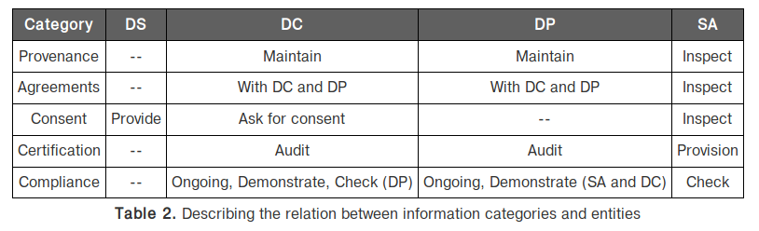
Major Interoperbility Data Categories

Slide 9
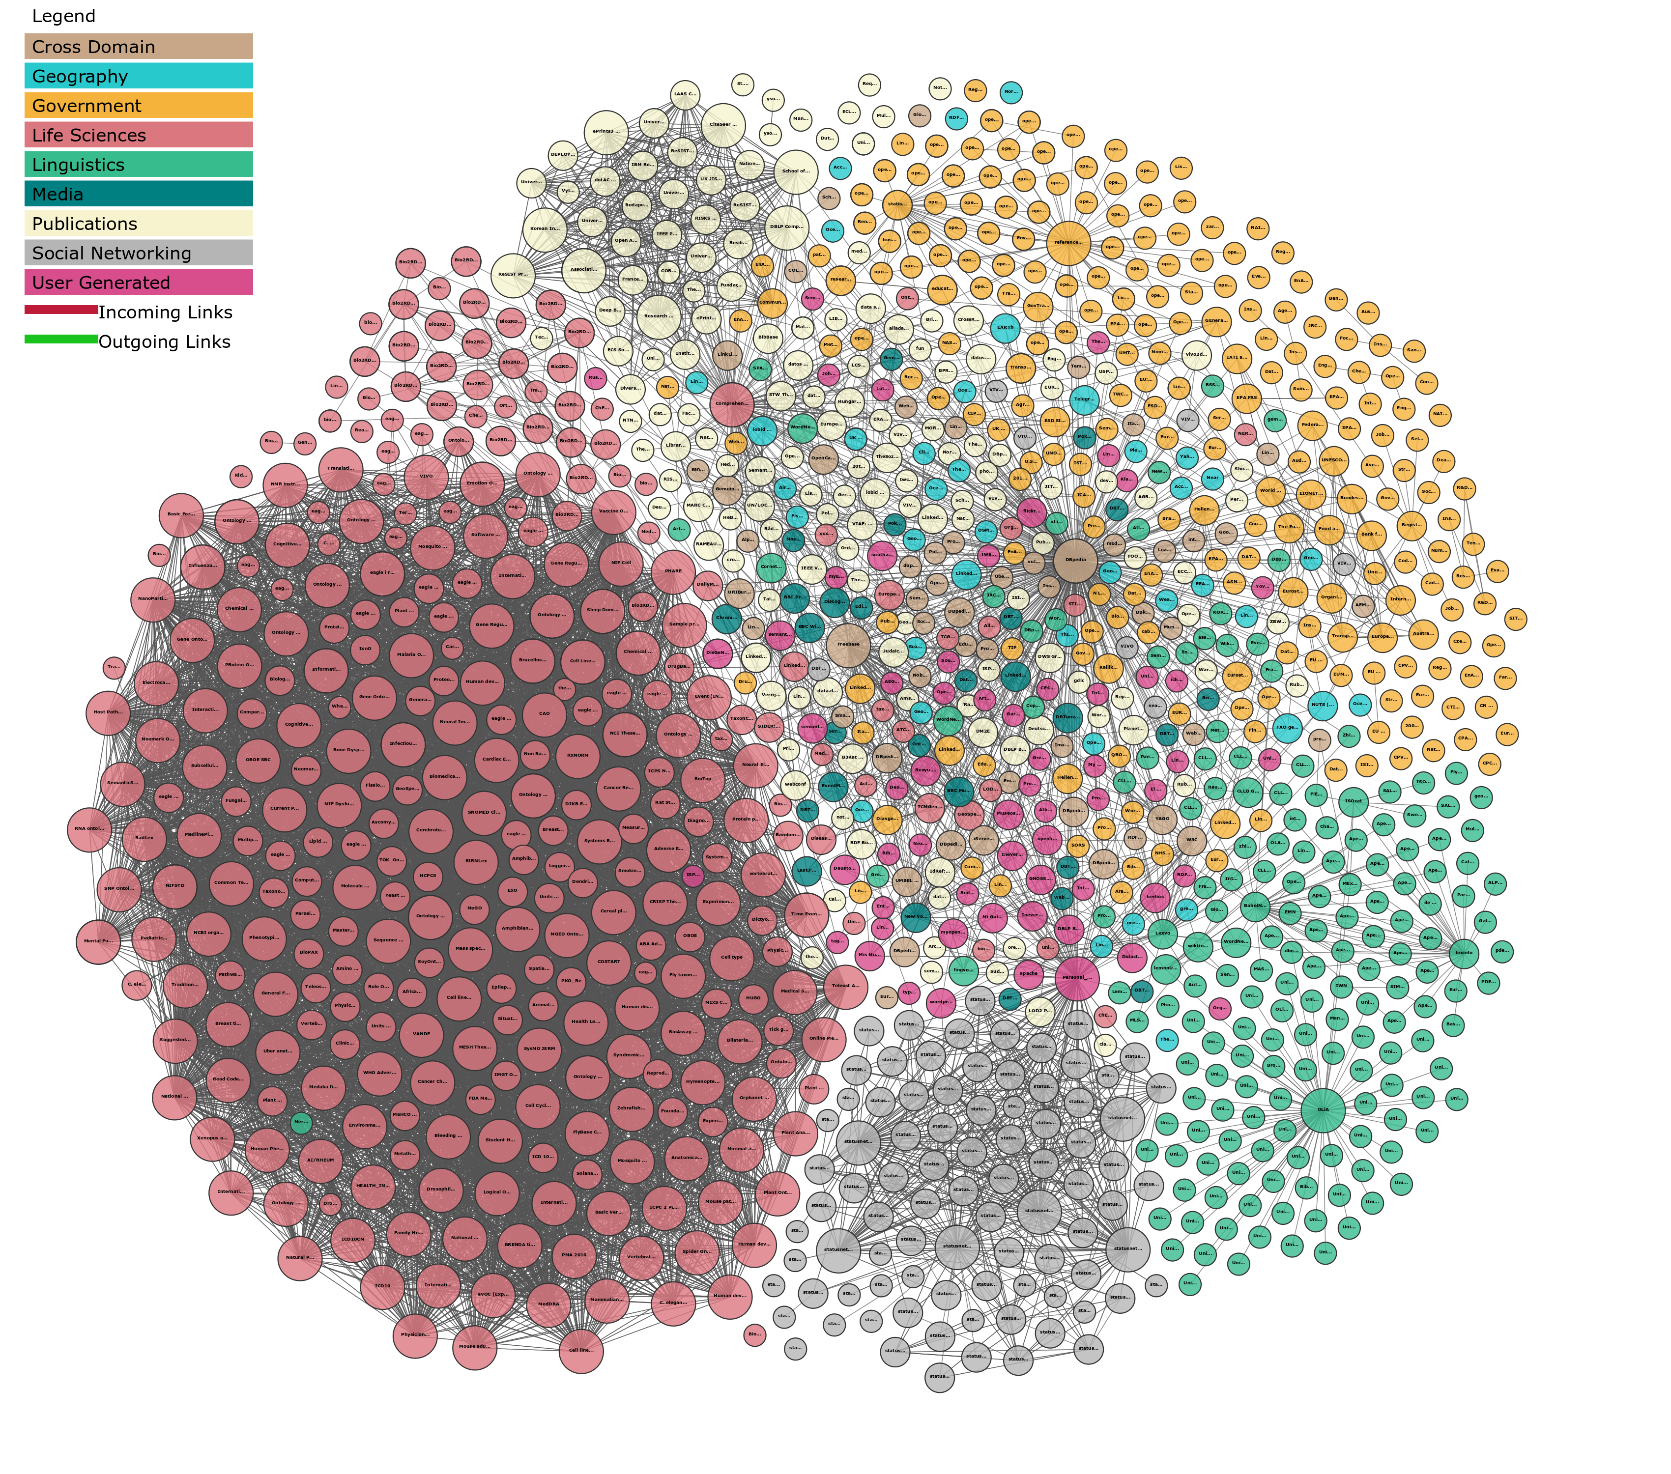
W3C Open Data
Open Data Standard for the Web
Resource Description Framework
Wide Adoption for Public Datasets
Conservative in standardisation - horizontal vocabularies
Liberal in community-driven development, extension and interlinking of data vocabularies
Enterprise Linked Data for internal knowledge graphs
https://lod-cloud.net/

Slide 10
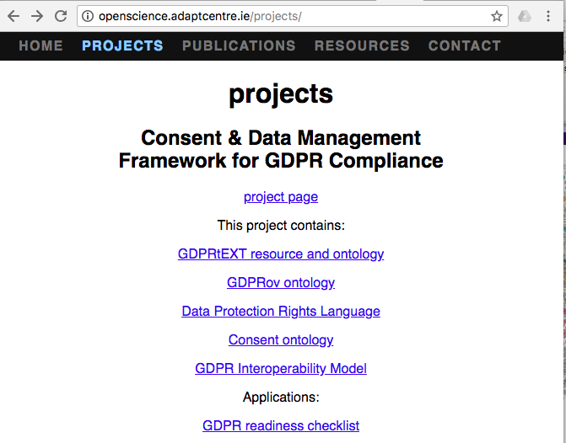
Open Science For GDPR Vocabularies
Linkable RDF version of GDPR Text
Consent Lifecycle Model
Provenance Ontology Profile for GDPR compliance logging
Data Protection Profile of Open Digital Rights Language
Traceability extendable to: decisions, policies, guidance, Privacy Seal requirements
RDF as a common format process and data models – R2RML for uplift
SPARQL Queries and SHACL Constraints for compliance checks
https://openscience.adaptcentre.ie/projects

Slide 11
Conclusion & Futher Work
Sufficient motivation for concerted efforts on GDPR interoperability
Initial Framework for Interoperability Reference Points for GDPR compliance processes
Focus on meta-data rather than the actual personal data
Propose an open data approach – leverages existing open standards for provenance, cataloguing, queries, constraints, deontic rules
Initiated an open science approach to fine-grained tracking of proposals against GDPR provisions and other regulatory/policy sources
Future Work:
Alignment with emerging open data research on data quality and data value
Standardisation avenues: W3C community group, ISO/IEC JTC1 SC42 “Trustworthy AI” study group

